Slide 1
GREEDY ALGORITHM

Slide 2
Definition
01
Working Mechanism
02
Table of contents
03
Characteristics
04
Applications

Slide 3
1.
Definition
What is Greedy Algorithm?

Slide 4
What is Greedy Algorithm?
Step 1
Step 2
Step n
locally optimal choice
locally optimal choice
locally optimal choice
global optimal choice

Slide 5
Discuss
What problems have you encountered that applied the Greedy Algorithm?

Slide 6
2.
Working Mechanism
Basic structure and Complexity

Slide 7
Return the money
Return a given amount of money using the least possible number of bills
Amount of money: 26 000 VND
Possible number of bills: 10 000 VND
5 000 VND
2 000 VND
1 000 VND

Slide 8
26 000 VND
10 000 VND
2
5 000 VND
1
2 000 VND
0
1 000 VND
1

Slide 9
Basic structure
Step 1: Define problem & all possible solutions (for each step)
Step 2: Determine benefit or value of each solution
Step 3: Select the solution with maximum benefit or value
Step 4: Repeat until the solution is complete

Slide 10
On each step, the choice made must be
1. Feasible
satisfy the problem’s constraints
2. Locally optimal
the best local choice among all feasible choices available on that step
3. Irrevocable
cannot be changed on subsequent steps

Slide 11
Time complexity
Is considered to be moderate
Depends on the specific problem and the specific implementation of the algorithm
Normally: O(n log n), O(n)

Slide 12
Return the money
Return a given amount of money using the least possible number of bills
Amount of money: 6 000 VND
Possible number of bills: 4 000 VND
3 000 VND
1 000 VND

Slide 13
6 000 VND
4 000 VND
1
3 000 VND
0
1 000 VND
2
4 000 VND
0
3 000 VND
2
1 000 VND
0

Slide 14
3.
Characteristics
Limitations, Advantages, Conditions

Slide 15
Limitations
1. Inability to backtrack
Lack of consideration for future steps
2. Suboptimality
Not always produce the optimal solution
3. Limited Scope
Is only suitable for a number of problems

Slide 16
Discuss
Why is the Greedy Algorithm widely used, especially in the field of computer science?

Slide 17
Advantages
Simple, easy to understand and implement
Faster and more efficient
Does not require large memory
Easy to combine with other algorithms
Offers a good approximation

Slide 18
Conditions for Using Greedy Algorithm
1. Optimal Substructure Property
The solution is divisible into smaller parts.
2. Greedy Choice Property
The locally optimal choice should always lead to the globally optimal solution.

Slide 19
4. Applications of greedy algorithm.

Slide 20
Applications of greedy algorithm.
Constructing Minimum Spanning Trees
Implement Huffman Encoding.
Solve Optimization Problems

Slide 21
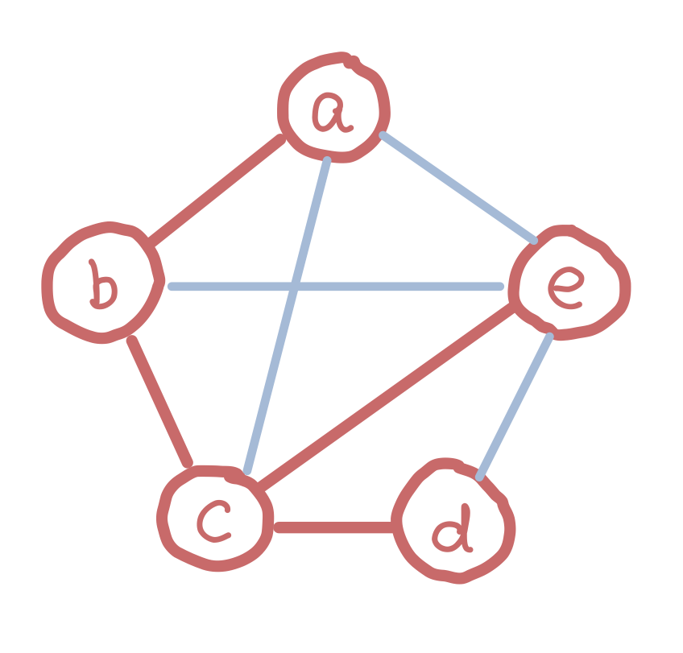
Constructing Minimum Spanning Trees.
What is a spanning tree?

Slide 22
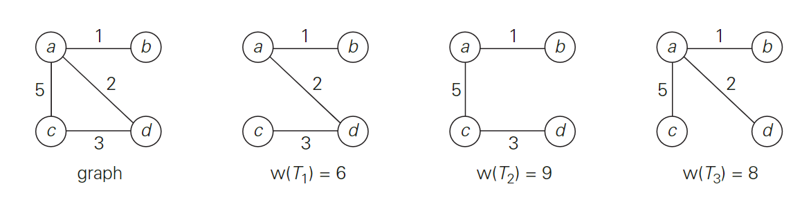
Instance of minimum spanning tree
Graph and its spanning trees, with $T_{1}$ being the minimum spanning tree.

Slide 23
Constructing Minimum Spanning Trees.
A minimum spanning tree is its spanning tree of the smallest weight, where the weight of a tree is defined as the sum of the weights on all its edges.
Find a minimum spanning tree?

Slide 24
Solution for minimum spanning tree.
Prim’s algorithm
Constructs a minimum spanning tree through a sequence of expanding subtrees. On each iteration, the algorithm expands the current tree in the greedy manner by simply attaching to it the nearest vertex not in that tree.
Kruskal’s algorithm
Constructs a minimum spanning tree as an expanding sequence of subgraphs (add the edge has smallest weight) that are always acyclic but are not necessarily connected on the intermediate stages of the algorithm.

Slide 25
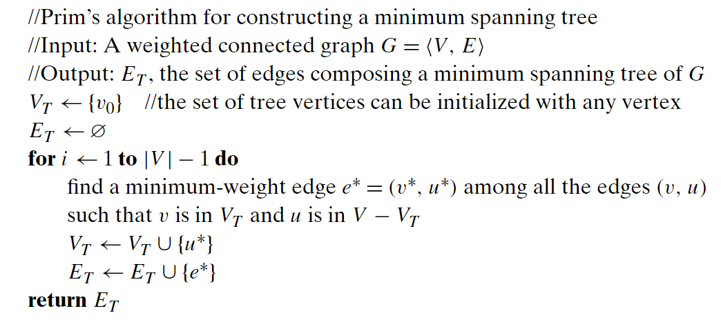
Pseudocode of Prim’s algorithm.

Slide 26
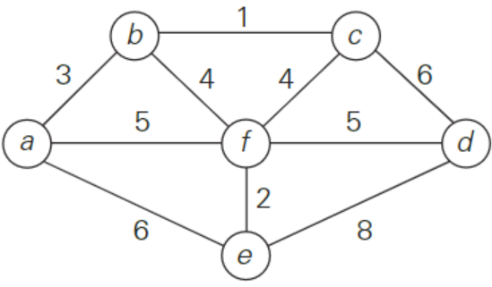
Example of Prim’s algorithm.

Slide 27
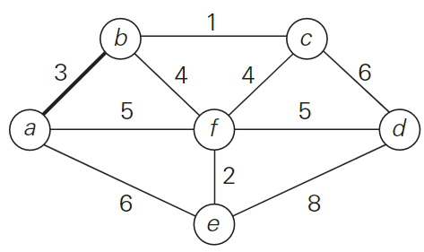
Example of Prim’s algorithm.

Slide 28
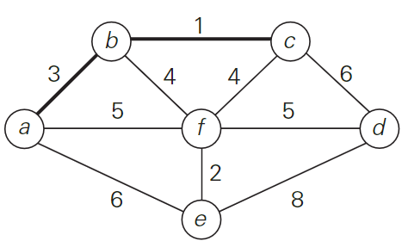
Example of Prim’s algorithm.

Slide 29
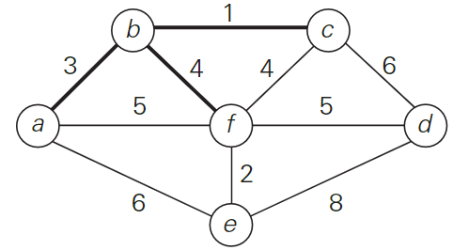
Example of Prim’s algorithm.

Slide 30
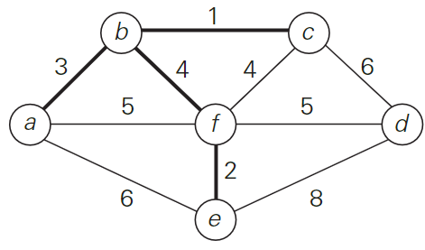
Example of Prim’s algorithm.

Slide 31
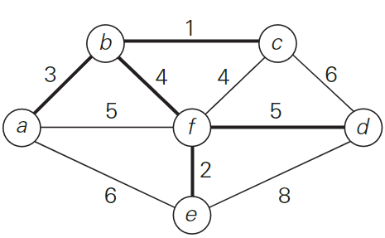
Example of Prim’s algorithm.

Slide 32
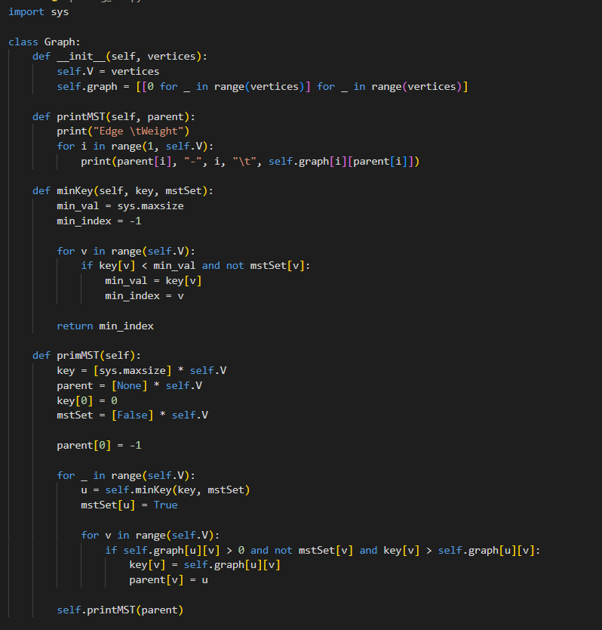
Code
Python
for
Prim’s
algorithm

Slide 33
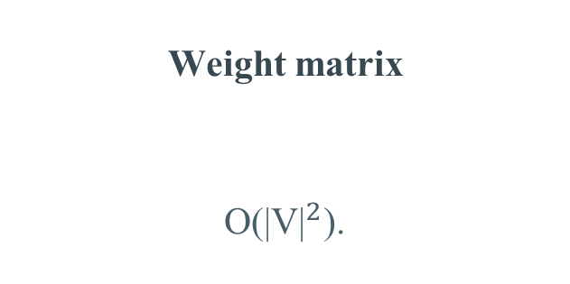
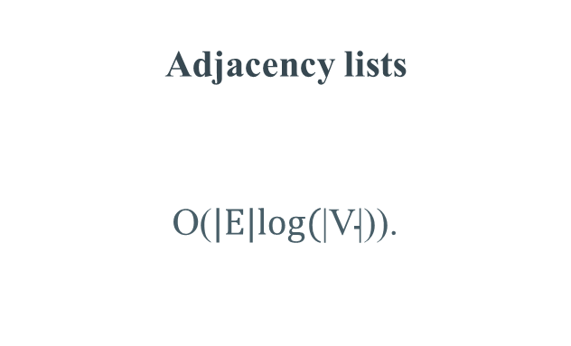
Time complexity of Prim’s algorithm.
V is the set of vertices in the graph
E is the set of edges in the graph
Weight matrix
O(${\text{|}\text{V}\text{|}}^{2}$).
Adjacency lists
O($\text{|}\text{E}\text{|}\text{log}\text{(}\text{|}\text{V}\text{|)}$).

Slide 34
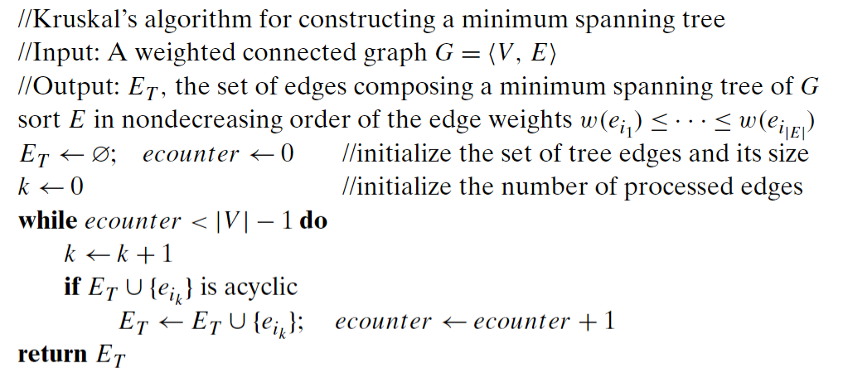
Pseudocode of Kruskal’s algorithm.

Slide 35
Instance of Kruskal’s algorithm.

Slide 36
Example of Kruskal’s algorithm.

Slide 37
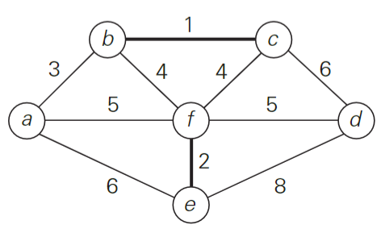
Example of Kruskal’s algorithm.

Slide 38
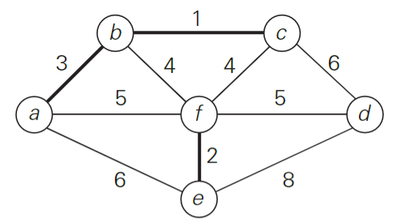
Example of Kruskal’s algorithm.

Slide 39
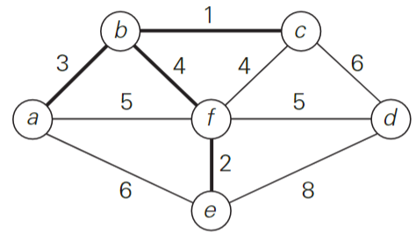
Example of Kruskal’s algorithm.

Slide 40
Example of Kruskal’s algorithm.

Slide 41
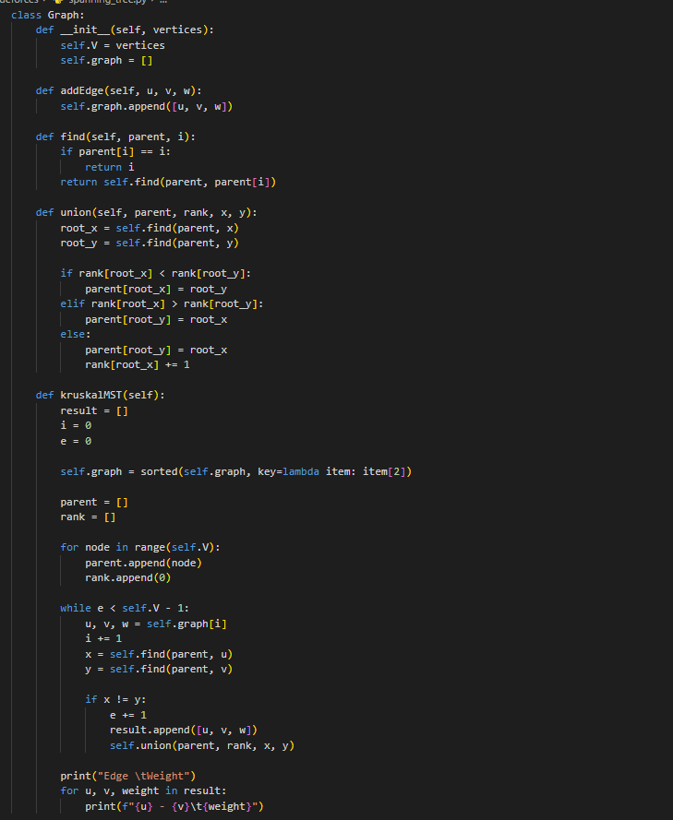
Code
Python
for
Kruskal’s
algorithm

Slide 42
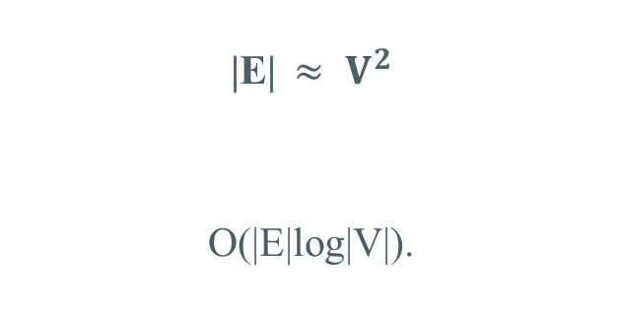
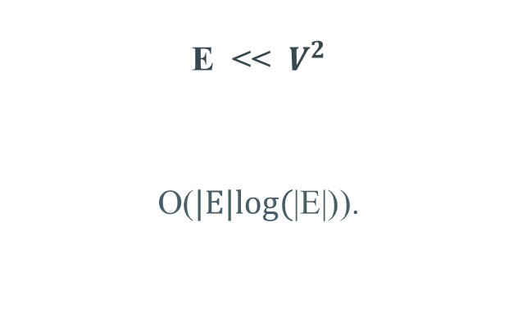
Time complexity of Kruskal’s algorithm.
V is the set of vertices in the graph
E is the set of edges in the graph
|E|$≈ V^{2}$
O(|E|log|V|).
E << $V^{2}$
O($\text{|}\text{E}\text{|}\text{log}\text{(}\text{|}\text{E}\text{|)}$).

Slide 43
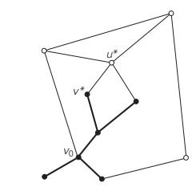
Single-source shortest-paths problem
What is the single-source shortest-paths problem?

Slide 44
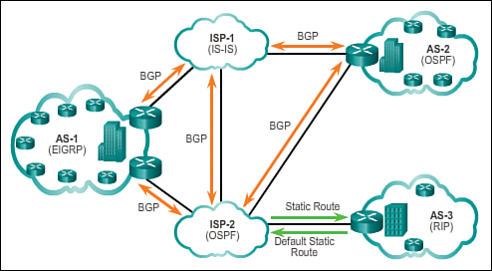
Single-source shortest-paths problem

Slide 45
Dijkstra’s Algorithm
Step 1: Set a source vertex distance as 0, and all other vertices as unvisited with a distance of infinity.
Step 2: Pick the unvisited vertex C with the smallest distance and visit it.
Step 3: The current vertex x, distances of its with min(d(C) + W(C, x), d(x)).
Repeat steps 2 and 3 until all vertices are visited, or the target vertex is reached (if specified).

Slide 46
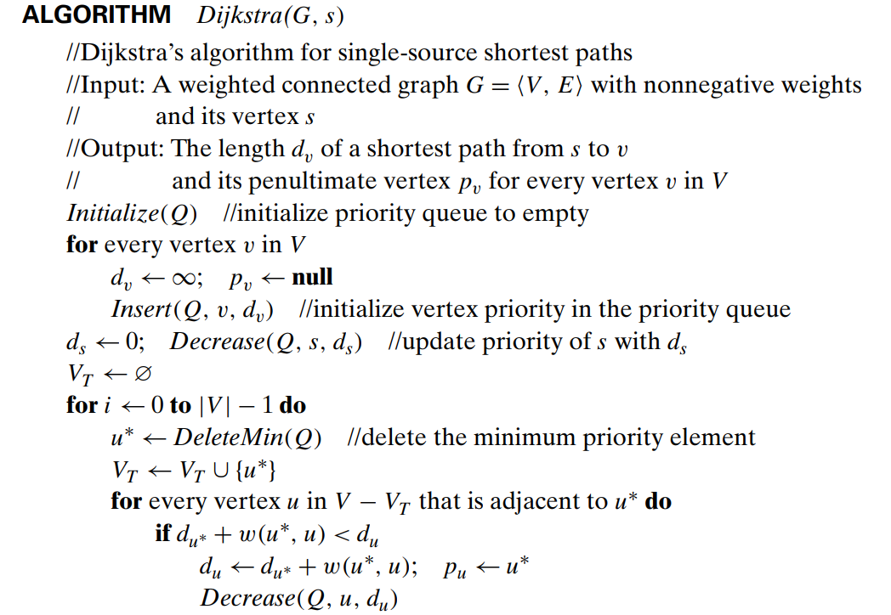
Pseudocode of Dijkstra’s Algorithm

Slide 47
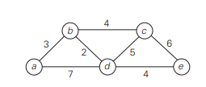
Example of Dijkstra’s Algorithm.

Slide 48
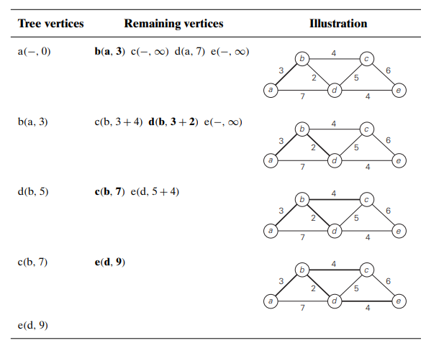
Example of Dijkstra’s Algorithm.

Slide 49
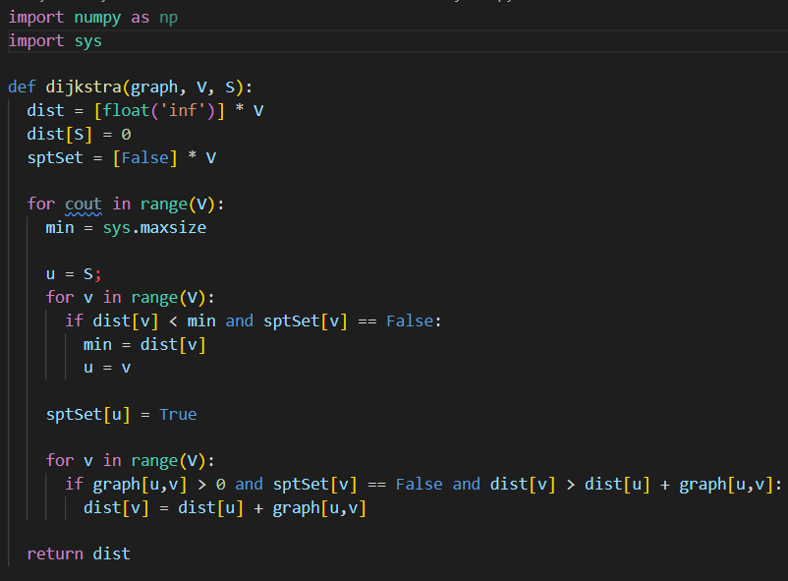
Code
Python
for
Kruskal’s
algorithm

Slide 50
Time complexity of Kruskal’s algorithm.
V is the set of vertices in the graph
E is the set of edges in the graph
|E|$≈ V^{2}$
O(|E|log|V|).
E << $V^{2}$
O($\text{|}\text{E}\text{|}\text{log}\text{(}\text{|}\text{E}\text{|)}$).

Slide 51
Discuss
The application of the greedy algorithm in cypersecurity

Slide 52

Data security in the cloud environment
What is the Data security?

Slide 53
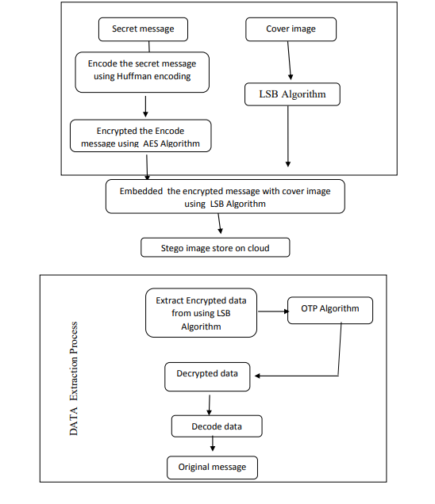
Methodology

Slide 54

Huffman’s Coding
What is the Huffman’s Coding?

Slide 55
Huffman’s Coding
Step 1: Calculate symbol frequencies.
Step 2: Create a binary tree using the frequencies. Combine two nodes with the lowest frequencies to create a new internal node
Step 3: Assign binary codes to each symbol based on the tree structure.
Step 4: Replace each symbol with its binary code.
Step 5: The compressed data stream is made up of the binary codes.

Slide 56
Huffman’s Coding
Step 1: Set a source vertex distance as 0, and all other vertices as unvisited with a distance of infinity.
Step 2: Pick the unvisited vertex C with the smallest distance and visit it.
Step 3: The current vertex x, distances of its with min(d(C) + W(C, x), d(x)).
Repeat steps 2 and 3 until all vertices are visited, or the target vertex is reached (if specified).

Slide 57
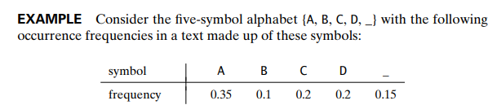
Example of Huffman’s Coding.

Slide 58
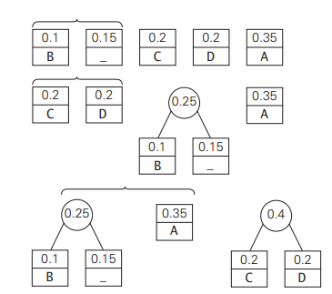
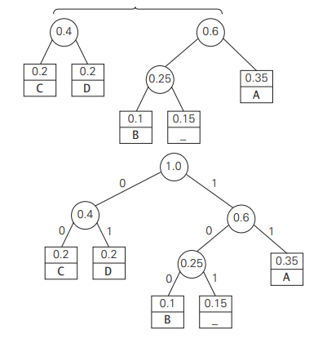
Example of Huffman’s Coding.

Slide 59
Example of Huffman’s Coding.

Slide 60
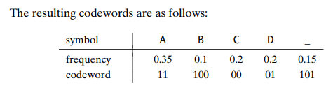
Example of Huffman’s Coding.
With text: ‘DAD’ is encoded ‘011101’
And code: ‘1001101101011101’ is decoded ‘BAD_DAD’

Slide 61
Thanks!
Any questions?

